Slide 1
Challenges / Solutions: Fabrication

Slide 2
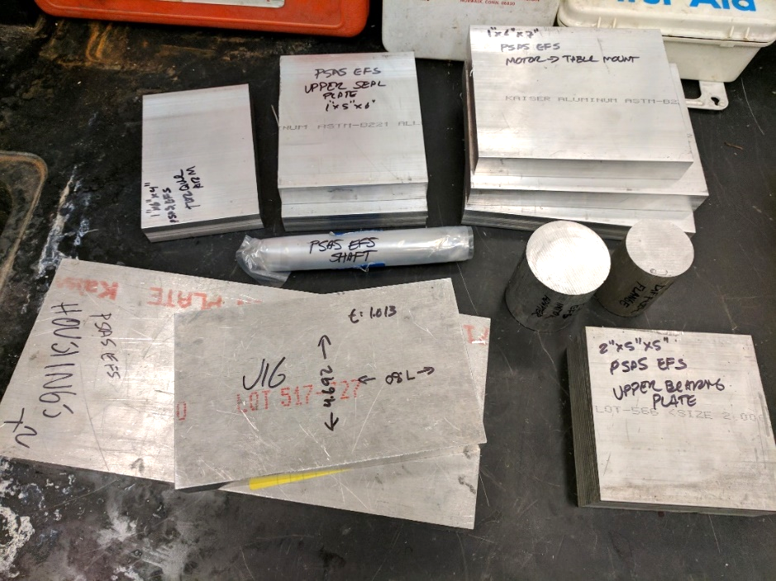
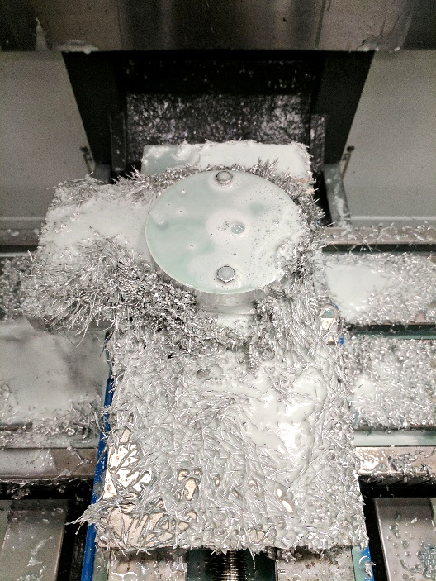
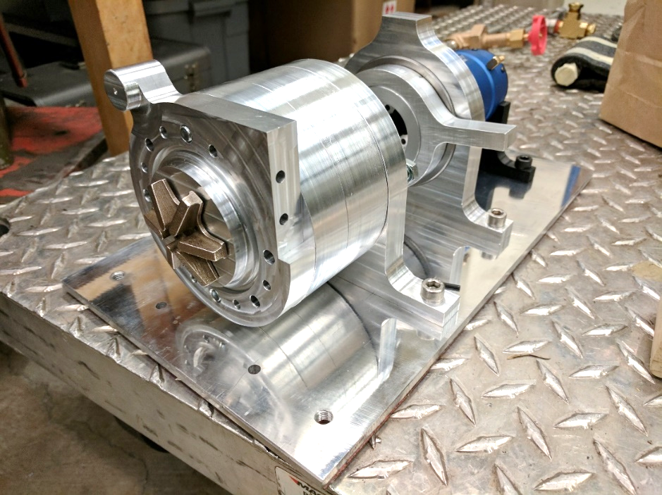
Challenge: Fabrication
Head v. flow requirements meant commercially available pumps wouldn’t work.
Outsourcing fabrication would be cost prohibitive.

Slide 3
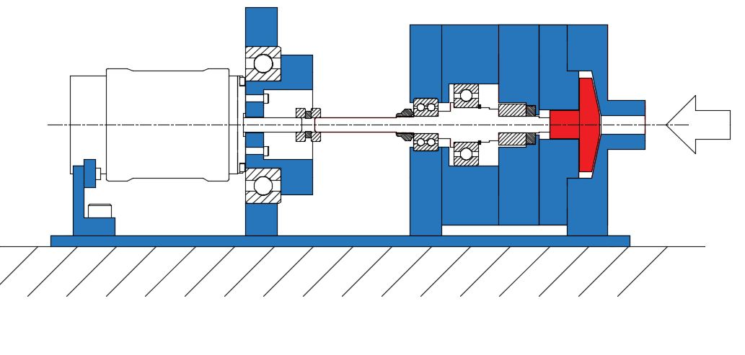
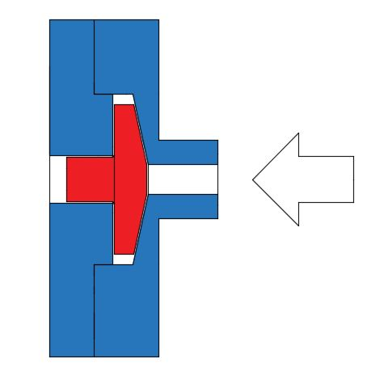
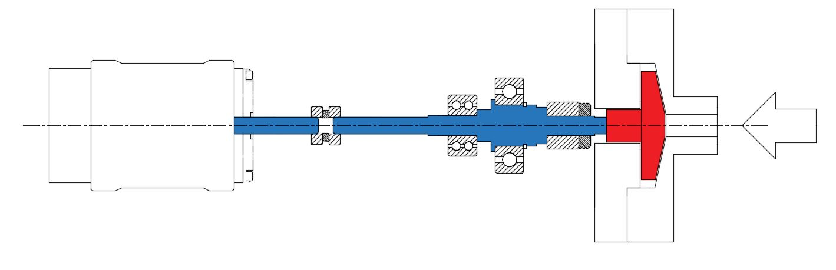
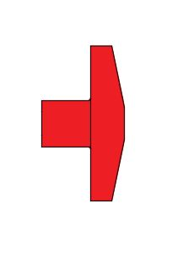
Challenge: Precision
High speeds and loads with low tolerances meant fabrication had to be precise.
+/- ~0.0007”
0.06” +/- 0.01”

Slide 4
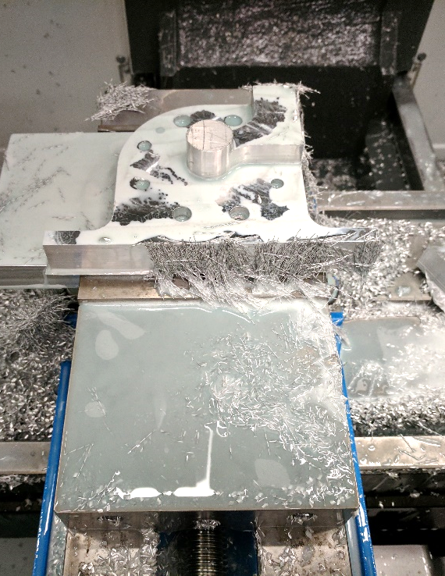
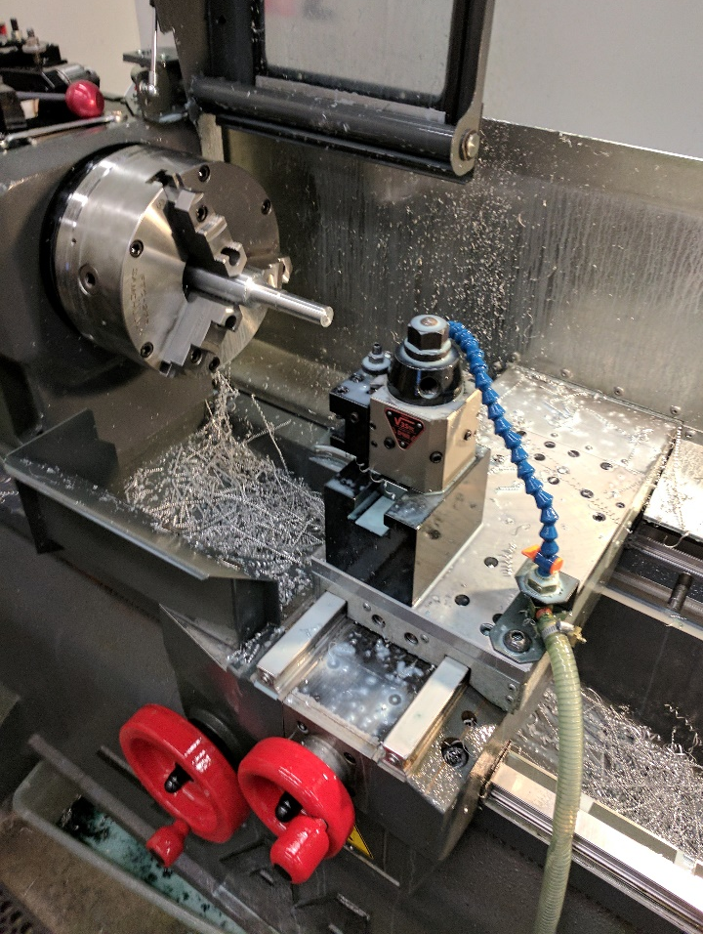
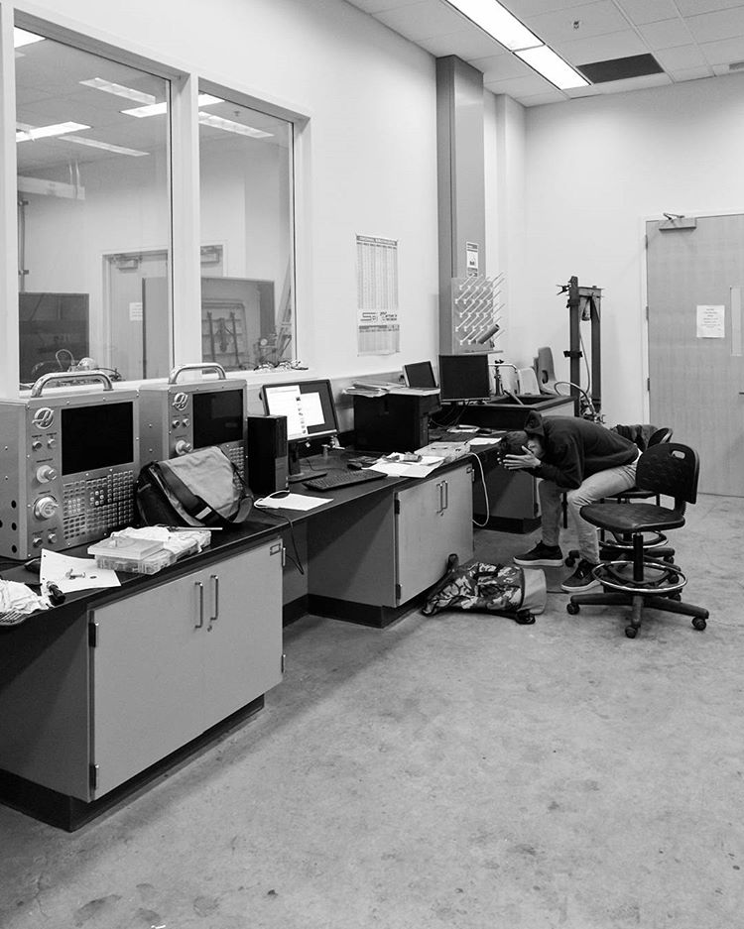
Solution: Time investment
Designed parts around available fabrication techniques.
Learned 3-axis CNC mill and 2 axis CNC lathe.
Several thousand (wo)man hours in the shop.

Slide 5
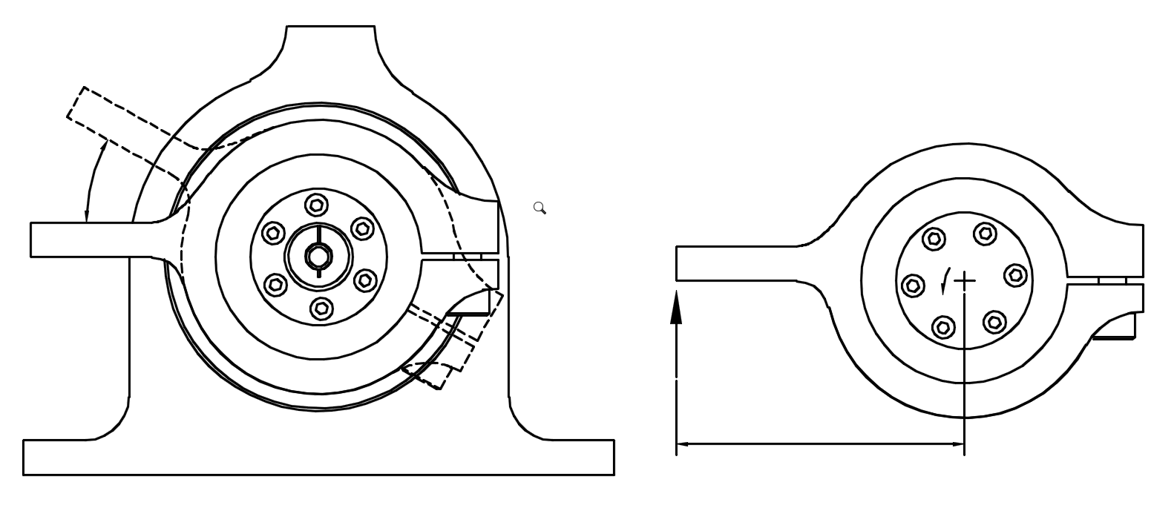
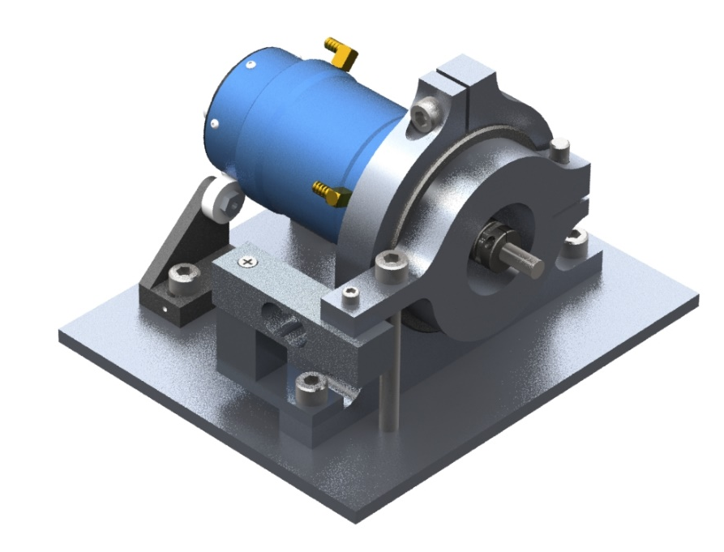
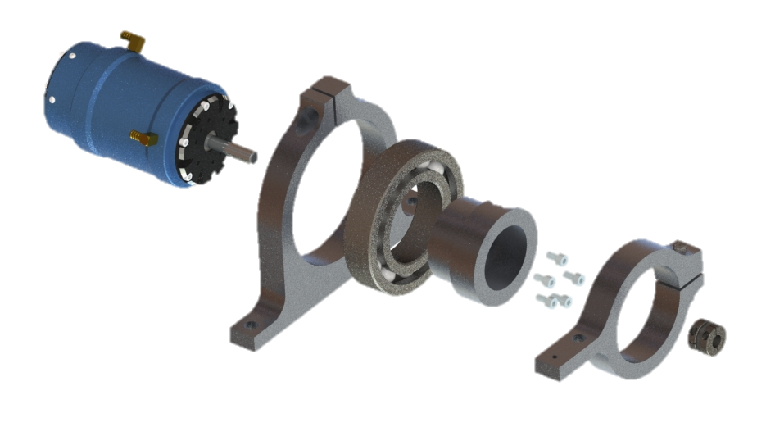
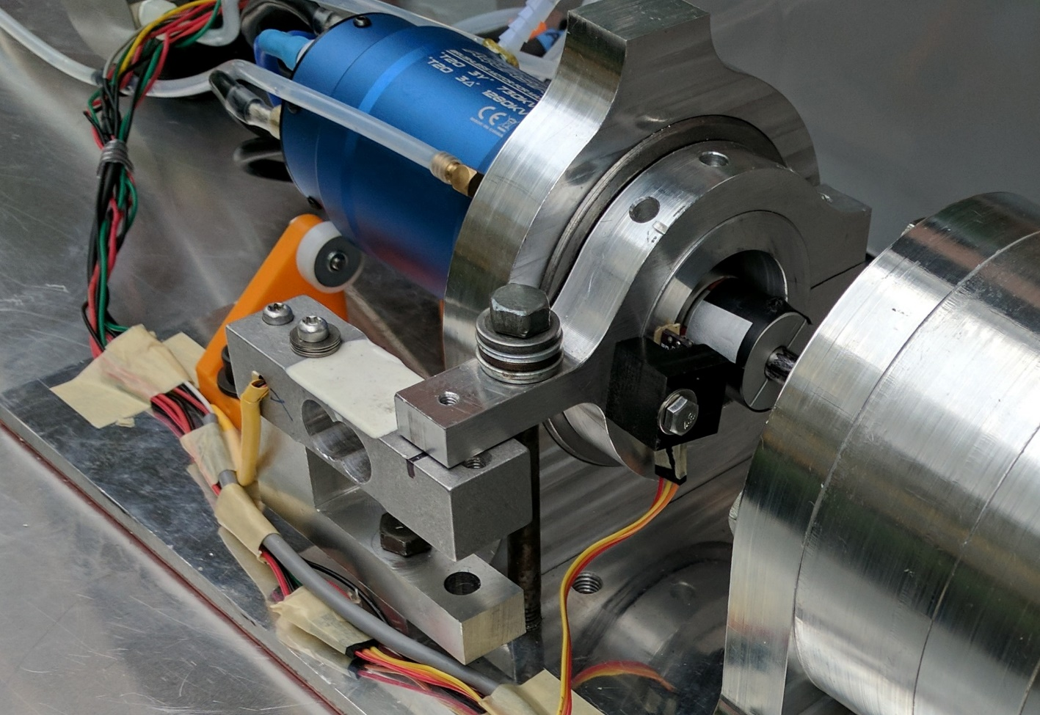
Challenge: Power measurement
We need to know the power applied to the fluid.
Hard to extract this data directly from motor.
Solution: live dynamometer.
“floating” motor adapter
motor
bearing
torque arm

